Slide 1
Time Series Covid Data Analysis - EDA
Lijju Mathew
November 22nd , 2020

Slide 2
Objectives
To identify source for Covid data for both US and Illinois.
Research key statistics that tells the severity of this pandemic.
Perform EDA.

Slide 3
Data
Dataset | United States | Illinois
Source | Covid Tracking Project (aggregated from different State departments) | IL Department of Public Health (Main source in Covid Tracking Project)
Time Frame | March 15th, 2020 | March 15th, 2020
Positive Cases | 11,748,947 | 634,395
Negative Cases | 141,583,445 | 8,954,303
Deaths | 245,537 | 11,304
Total Tests | 175,636,376 | 9,588,698

Slide 4
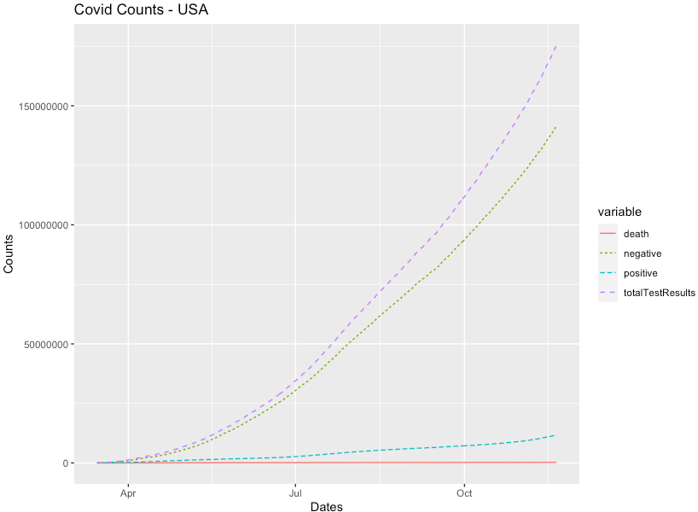
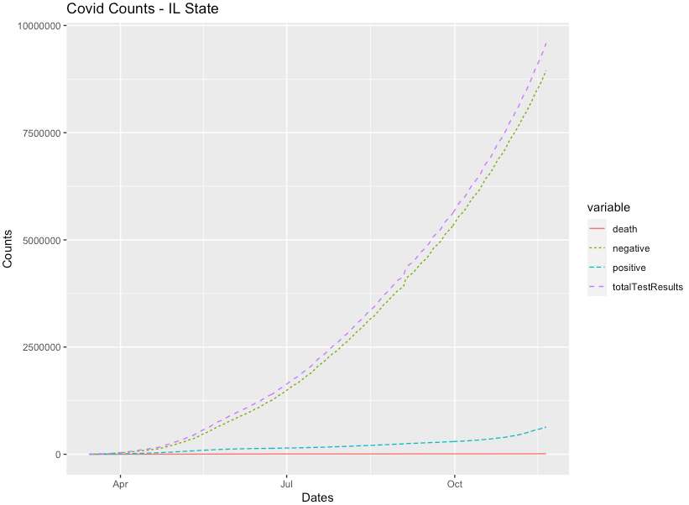
Data

Slide 5
Data
Positivity Rate
(positive tests)/(total tests) x 100%
High Positivity
Low Positivity
Daily Positivity Rate

Slide 6
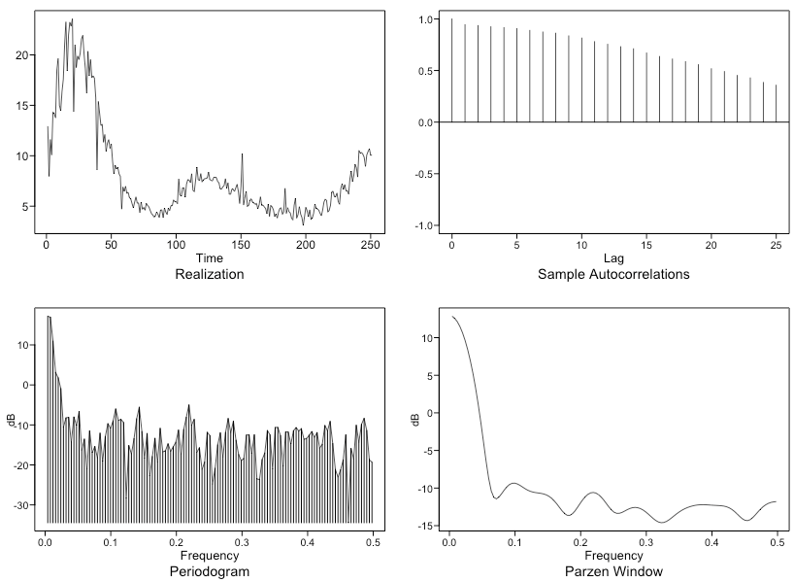
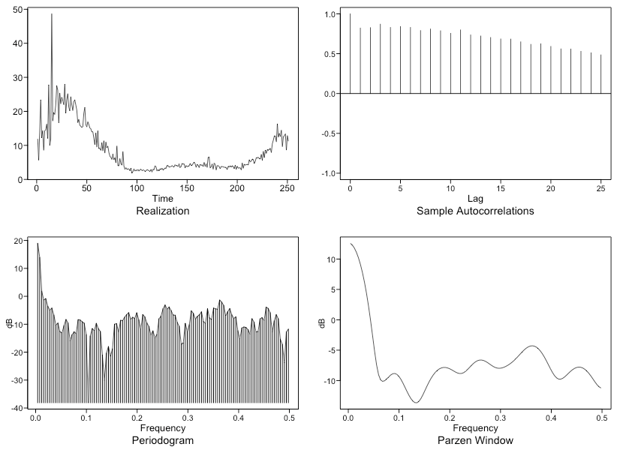
Data
US
IL
Data appears to be wander
Slow dampening ACFs
Evidence of non-stationary data.
No evidence of seasonality.
Data appears to be wander
Slow dampening ACFs
Evidence of non-stationary data.
No evidence of seasonality.

Slide 7
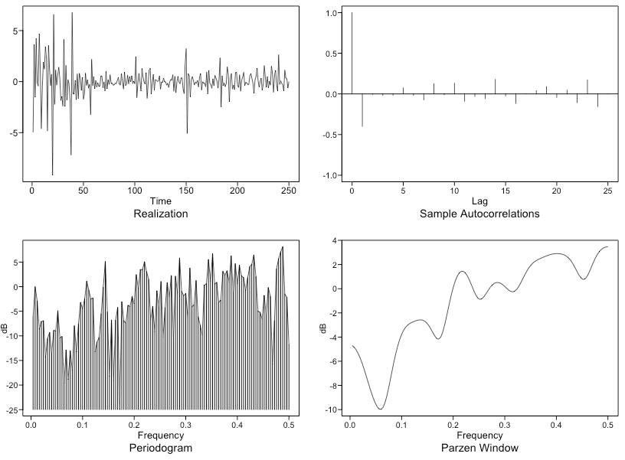
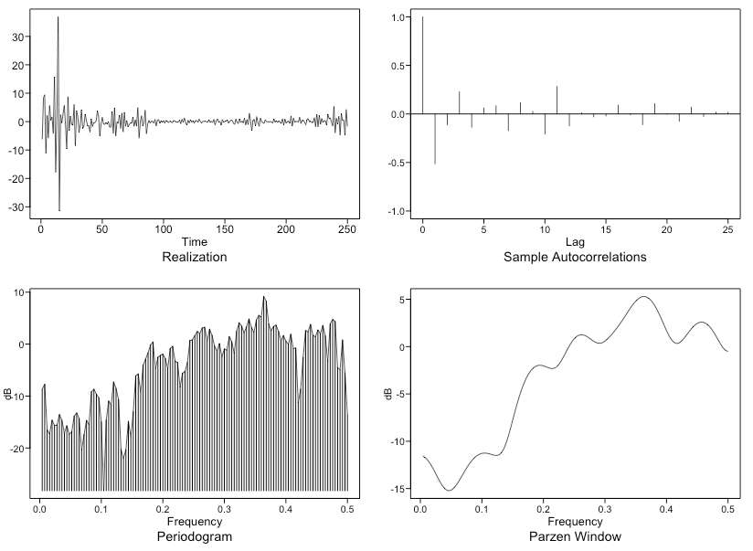
Models
US
IL
First difference.
aic5 identified below two top models.
ARIMA(5,1,1)
ARIMA(0,1,1)
First difference.
aic5 identified below two top models.
ARIMA(2,1,1)
ARIMA(4,1,2)

Slide 8
Models
US
IL
Model 1 - ARIMA(5,1,1)
ASE – 4.04
Rolling ASE – 2.21
Model 2 - ARIMA(0,1,1)
ASE – 7.5
Rolling ASE – 2.30
Final Model - ARIMA(5,1,1)
Model 1 - ARIMA(4,1,2)
ASE – 23.55
Rolling ASE – 4.04
Model 2 - ARIMA(2,1,1)
ASE – 24.88
Rolling ASE – 4.09
Final Model - ARIMA(4,1,2)

Slide 9
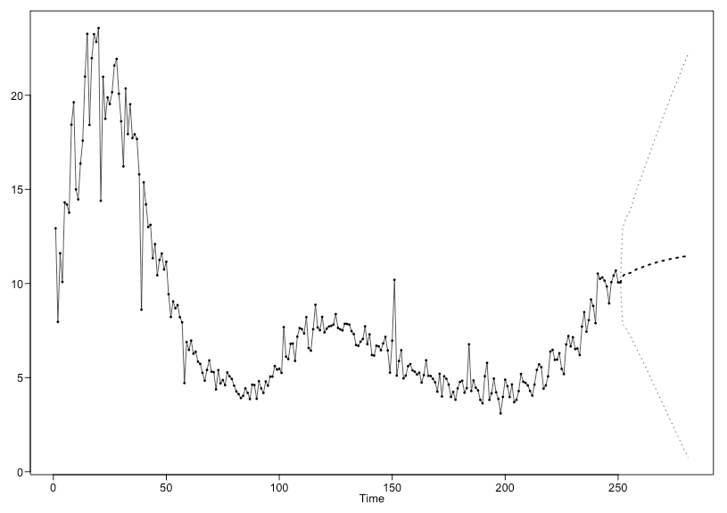
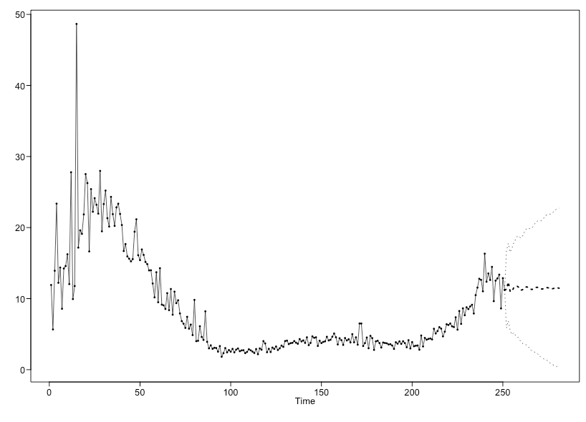
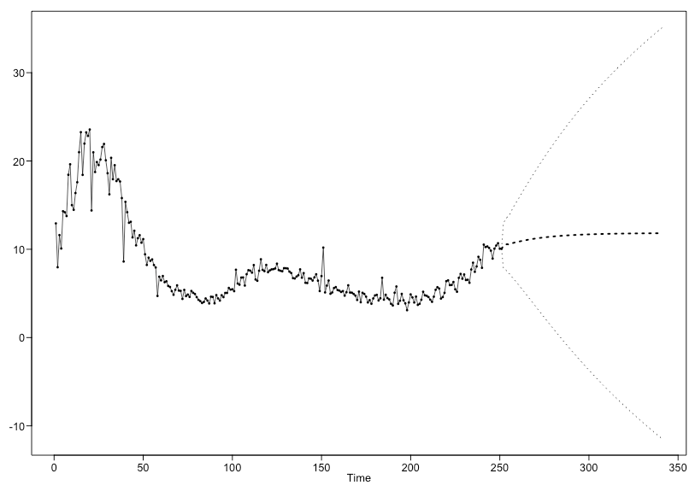
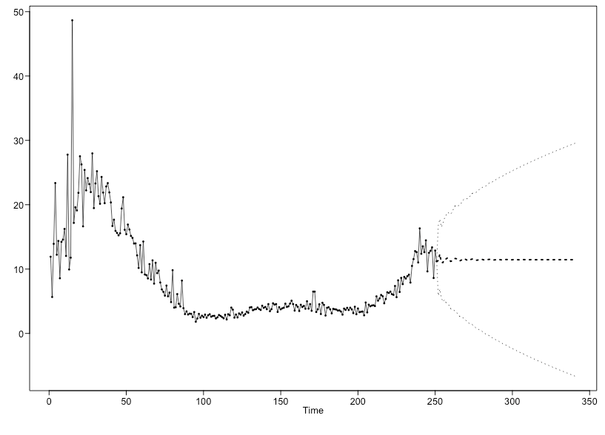
Forecasts
US
IL
Short Term
Forecast
1 month
Long Term
Forecast
3 month

Slide 10
Next Steps
Research further that could solidify the models like residual analysis.
Explore multivariate analysis and further modelling techniques like MLR, MLP, Var models.

Slide 11
Artifacts
Github Link - https://github.com/lijjumathew/MSDS-Time-Series-Covid-Analysis.git
Youtube Presentation Link -

